Slide 1

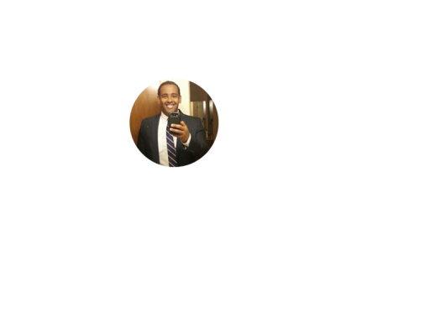
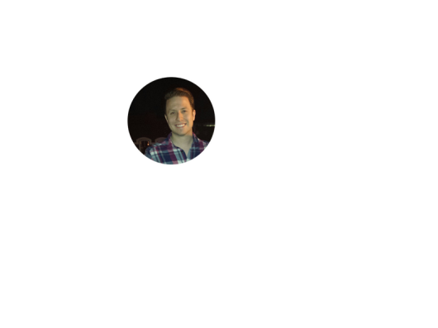

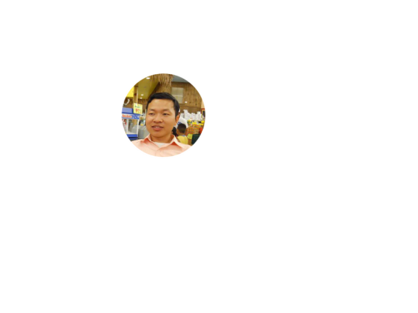
Project: Home Irrigation Control System (HICS) Team: SmartGrass
Team Status Report
May 1st, 2015
Belachew
Haile-Mariam
Gautam
Adhikari
Jeremiah
O’Connor
Tung
Vo
Notes:
This presentation demonstrates the new capabilities of PowerPoint and it is best viewed in Slide Show. These slides are designed to give you great ideas for the presentations you’ll create in PowerPoint 2010!
For more sample templates, click the File tab, and then on the New tab, click Sample Templates.

Slide 2
Packaging Progress
Power Housing and Cables
Made the wires shorter and organized the wires going in and out of the HICS
Used Velcro to permanently fix the location of hardware
Taped wires and labeled relay modules
Glued , taped and soldered all connecting wires
Gave HICS a unibody design

Slide 3
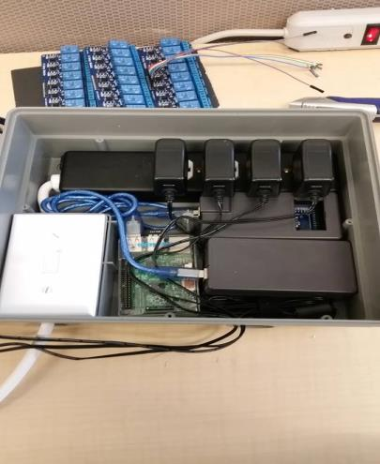
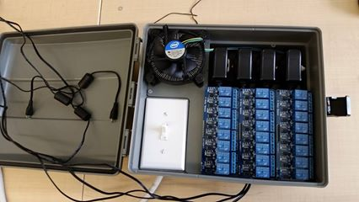
Packaging Progress
Power Housing and Cables
Top Layer
Underneath

Slide 4
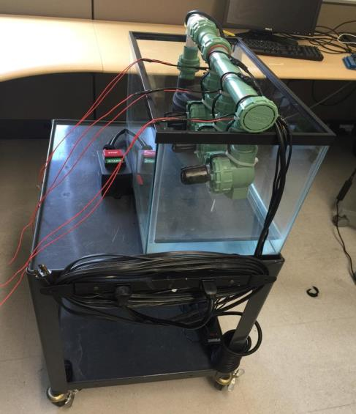
Packaging Progress
Power Housing and Cables

Slide 5
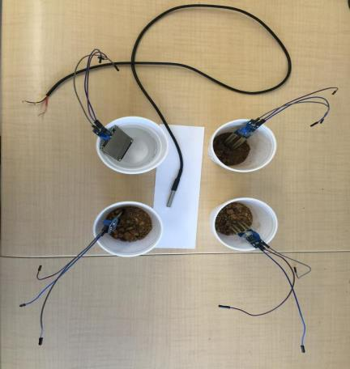
Prototype Development
Sensors
Tested sensors each environmental condition
Calibrated the readings
Testing the thresholds for each sensor

Slide 6
Prototype Development
Integration Process
Migrated Raspberry Pi and Arduinos over to case and established connections between them
Connected each sensor to the relay boards
Converted all dummy data over to actual sensor readings on web application

Slide 7

Prototype Development
Web Application UI

Slide 8
Prototype Development
Web Application UI
Added settings page and integrated the logic to turn off sensors if environment thresholds are met (i.e. rain, temperature)
Switched dummy data for reports, and landing page, over to real sensor readings
Added Session States to store a users Id and Role upon login to validate permissions (admin vs regular user)

Slide 9
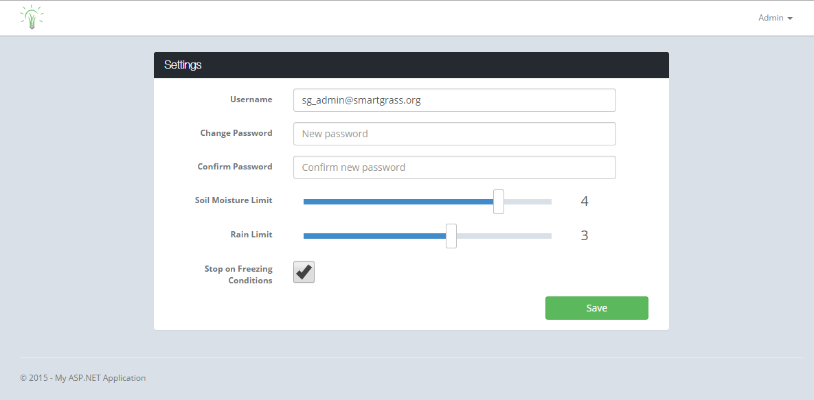
WEB APPLICATION PROGRESS
Web Application UI – Settings Page

Slide 10
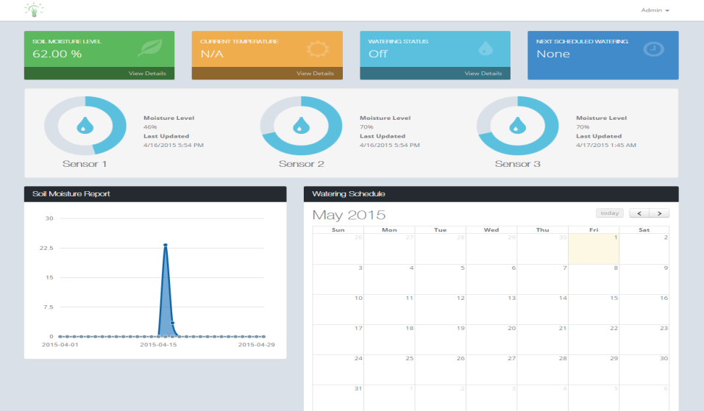
WEB APPLICATION PROGRESS
Web Application UI – Unit Status & Reports

Slide 11

Web Application Progress
Web Application UI – Landing Page

Slide 12
Prototype Development
Final Tasks
Finish Admin dashboard on web application
Wire and secure all remaining sensors
Create our presentation Tri-fold board
Work on and review our presentation for our demo
Test demo inside the classroom where the presentation will be held

Slide 13

Any Questions?
?

